Slide 1


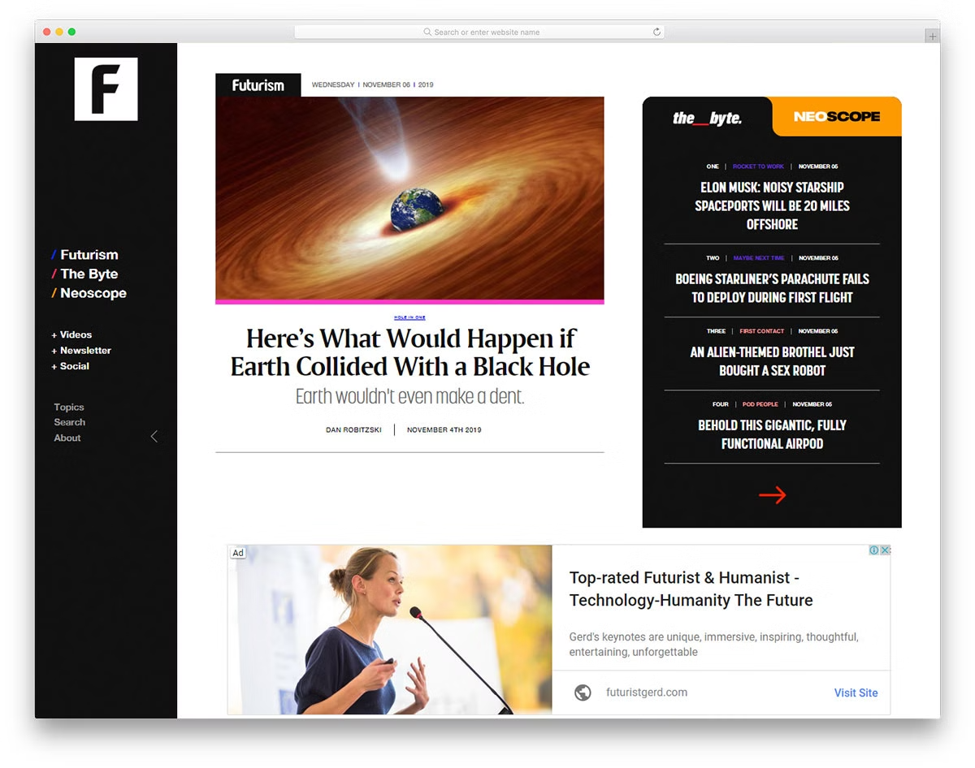

Welcome to Our News Website
Our website provides you with the latest news from around the world. We strive to deliver accurate and timely information.
by Suraj Gupta
SG

Slide 2

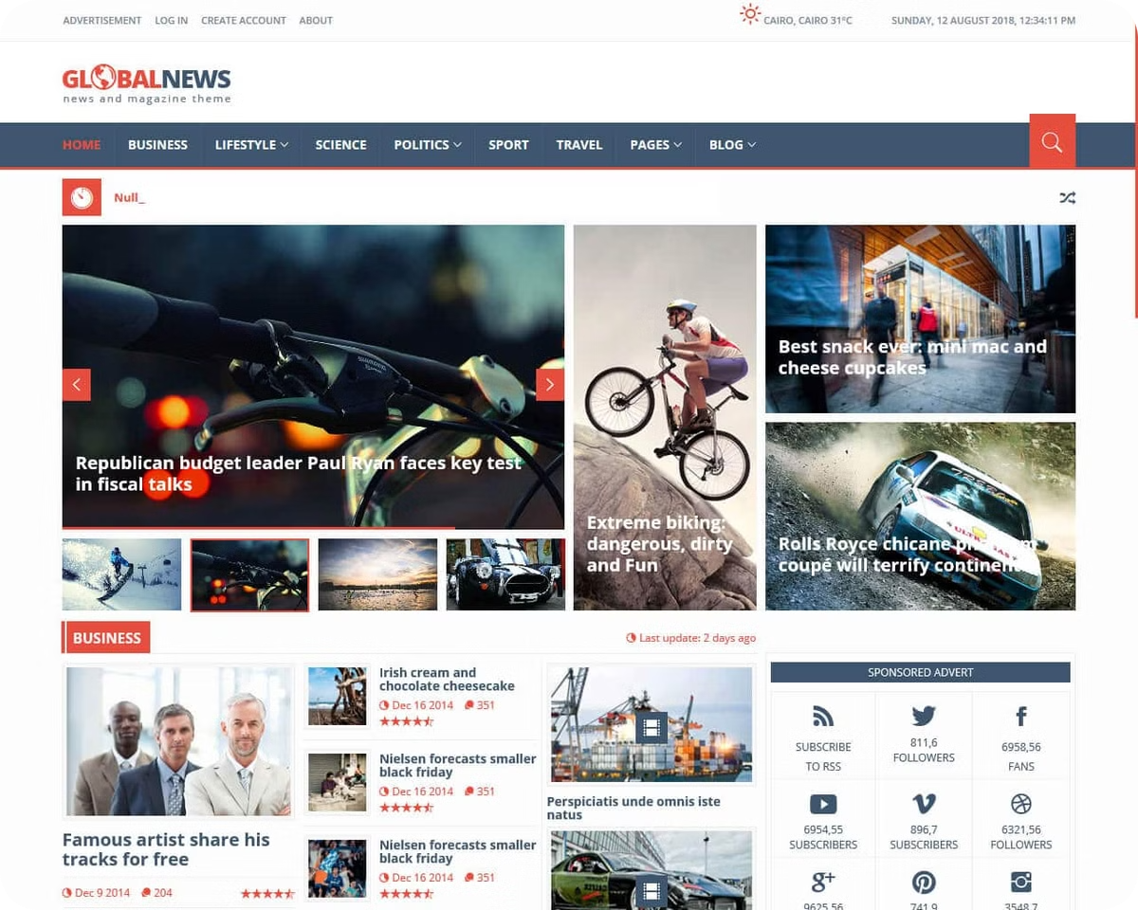
News Section
Breaking News
World News
Stay updated with the most recent events happening globally.
Get insights into international affairs and events.
Business News
Sports News
Follow the latest trends and developments in the global economy.
Stay informed about your favorite sports and athletes.

Slide 3

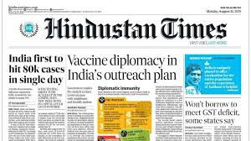
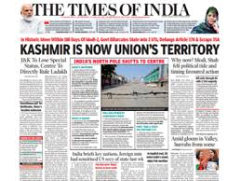
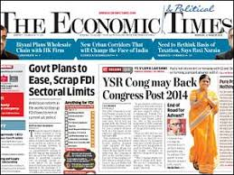
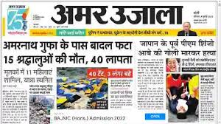
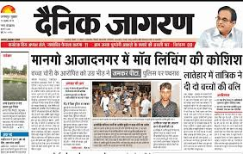
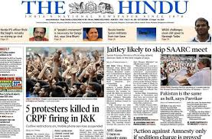
HEADLINES
Top News Headlines
1
International Affairs
2
Business and Finance
Covering global events, conflicts, and diplomatic relations.
Reporting on market trends, company news, and economic indicators.
3
Technology and Innovation
4
Entertainment and Culture
Exploring advancements in technology, science, and engineering.
Providing coverage of movies, music, art, and pop culture.

Slide 4
Front-end Technology: CSS, HTML
HTML
CSS
The foundation of our website, defining the structure and content.
Styling and presentation of our website, enhancing visual appeal.

Slide 5


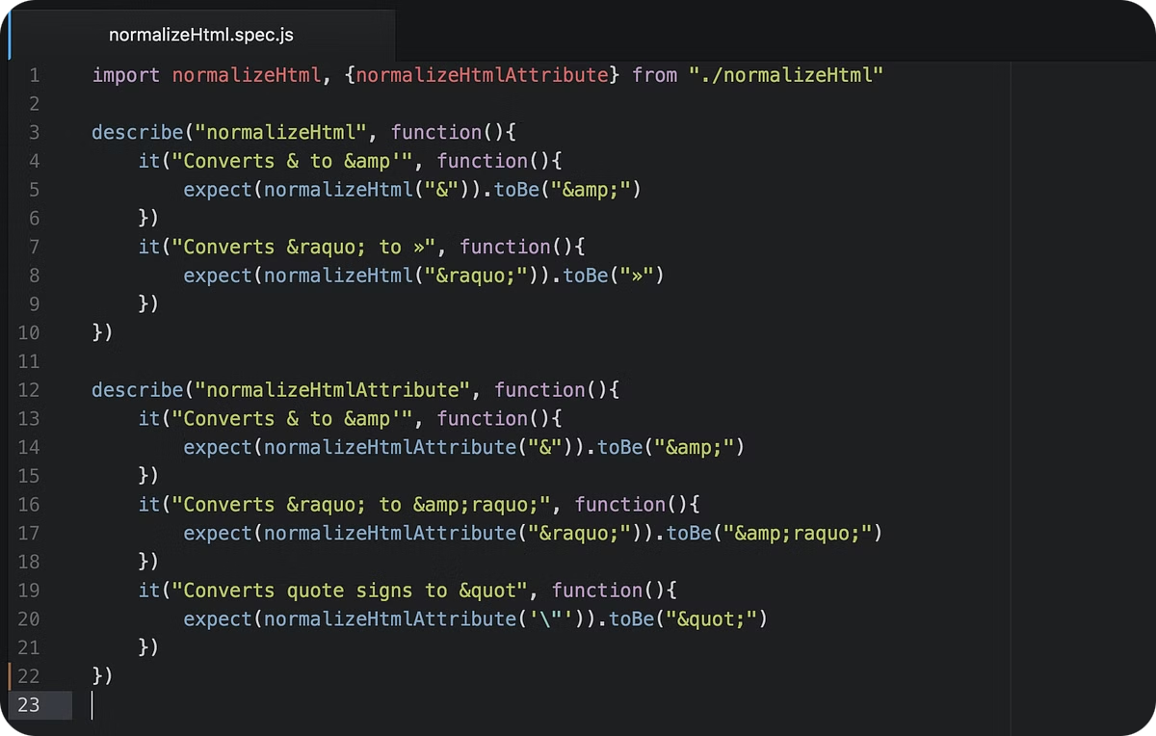


Back-end Technology: JavaScript
User Interactions
Enabling dynamic elements, like interactive forms and menus.
Data Processing
Handling user requests and data manipulation.
Content Management
Powering the website's functionality and responsiveness.

Slide 6

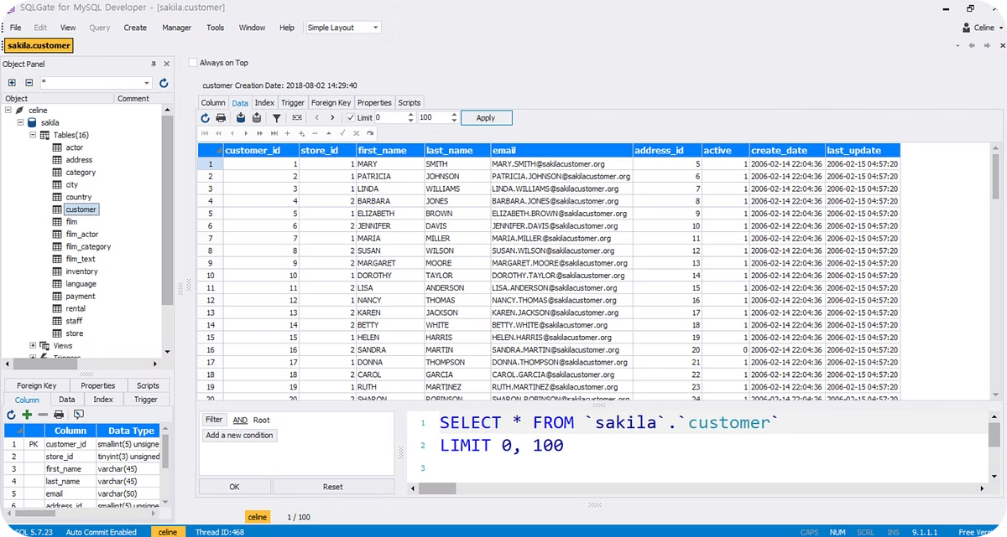
Database Technology: SQL
Data Storage
Managing and organizing vast amounts of information.
Data Retrieval
Efficiently accessing and retrieving data for website display.
Data Integrity
Ensuring data accuracy and consistency.

Slide 7

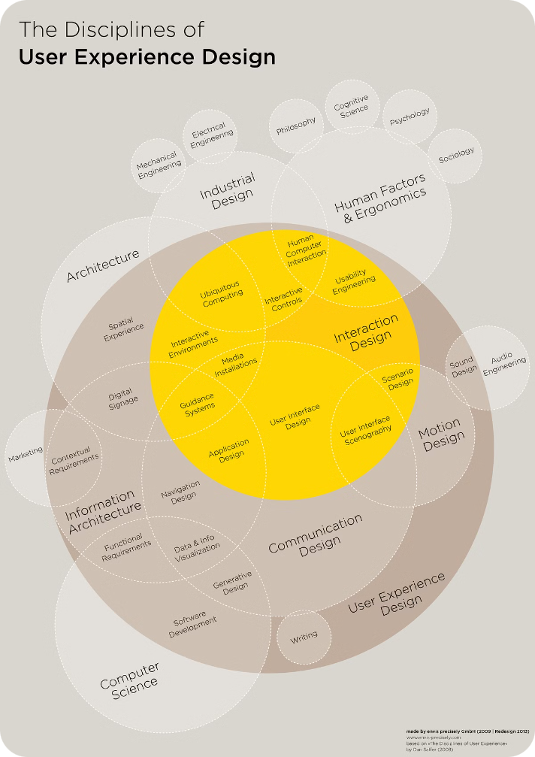



User Experience
Accessibility
Making our website usable and enjoyable for all users.
Performance
Ensuring fast loading times and smooth browsing.
Feedback
Continuously improving our website based on user input.

Slide 8


Thank You
We appreciate your interest in our website. We hope you enjoy our news content and find it informative.

